Slide 1
sconce v0.99

Slide 2
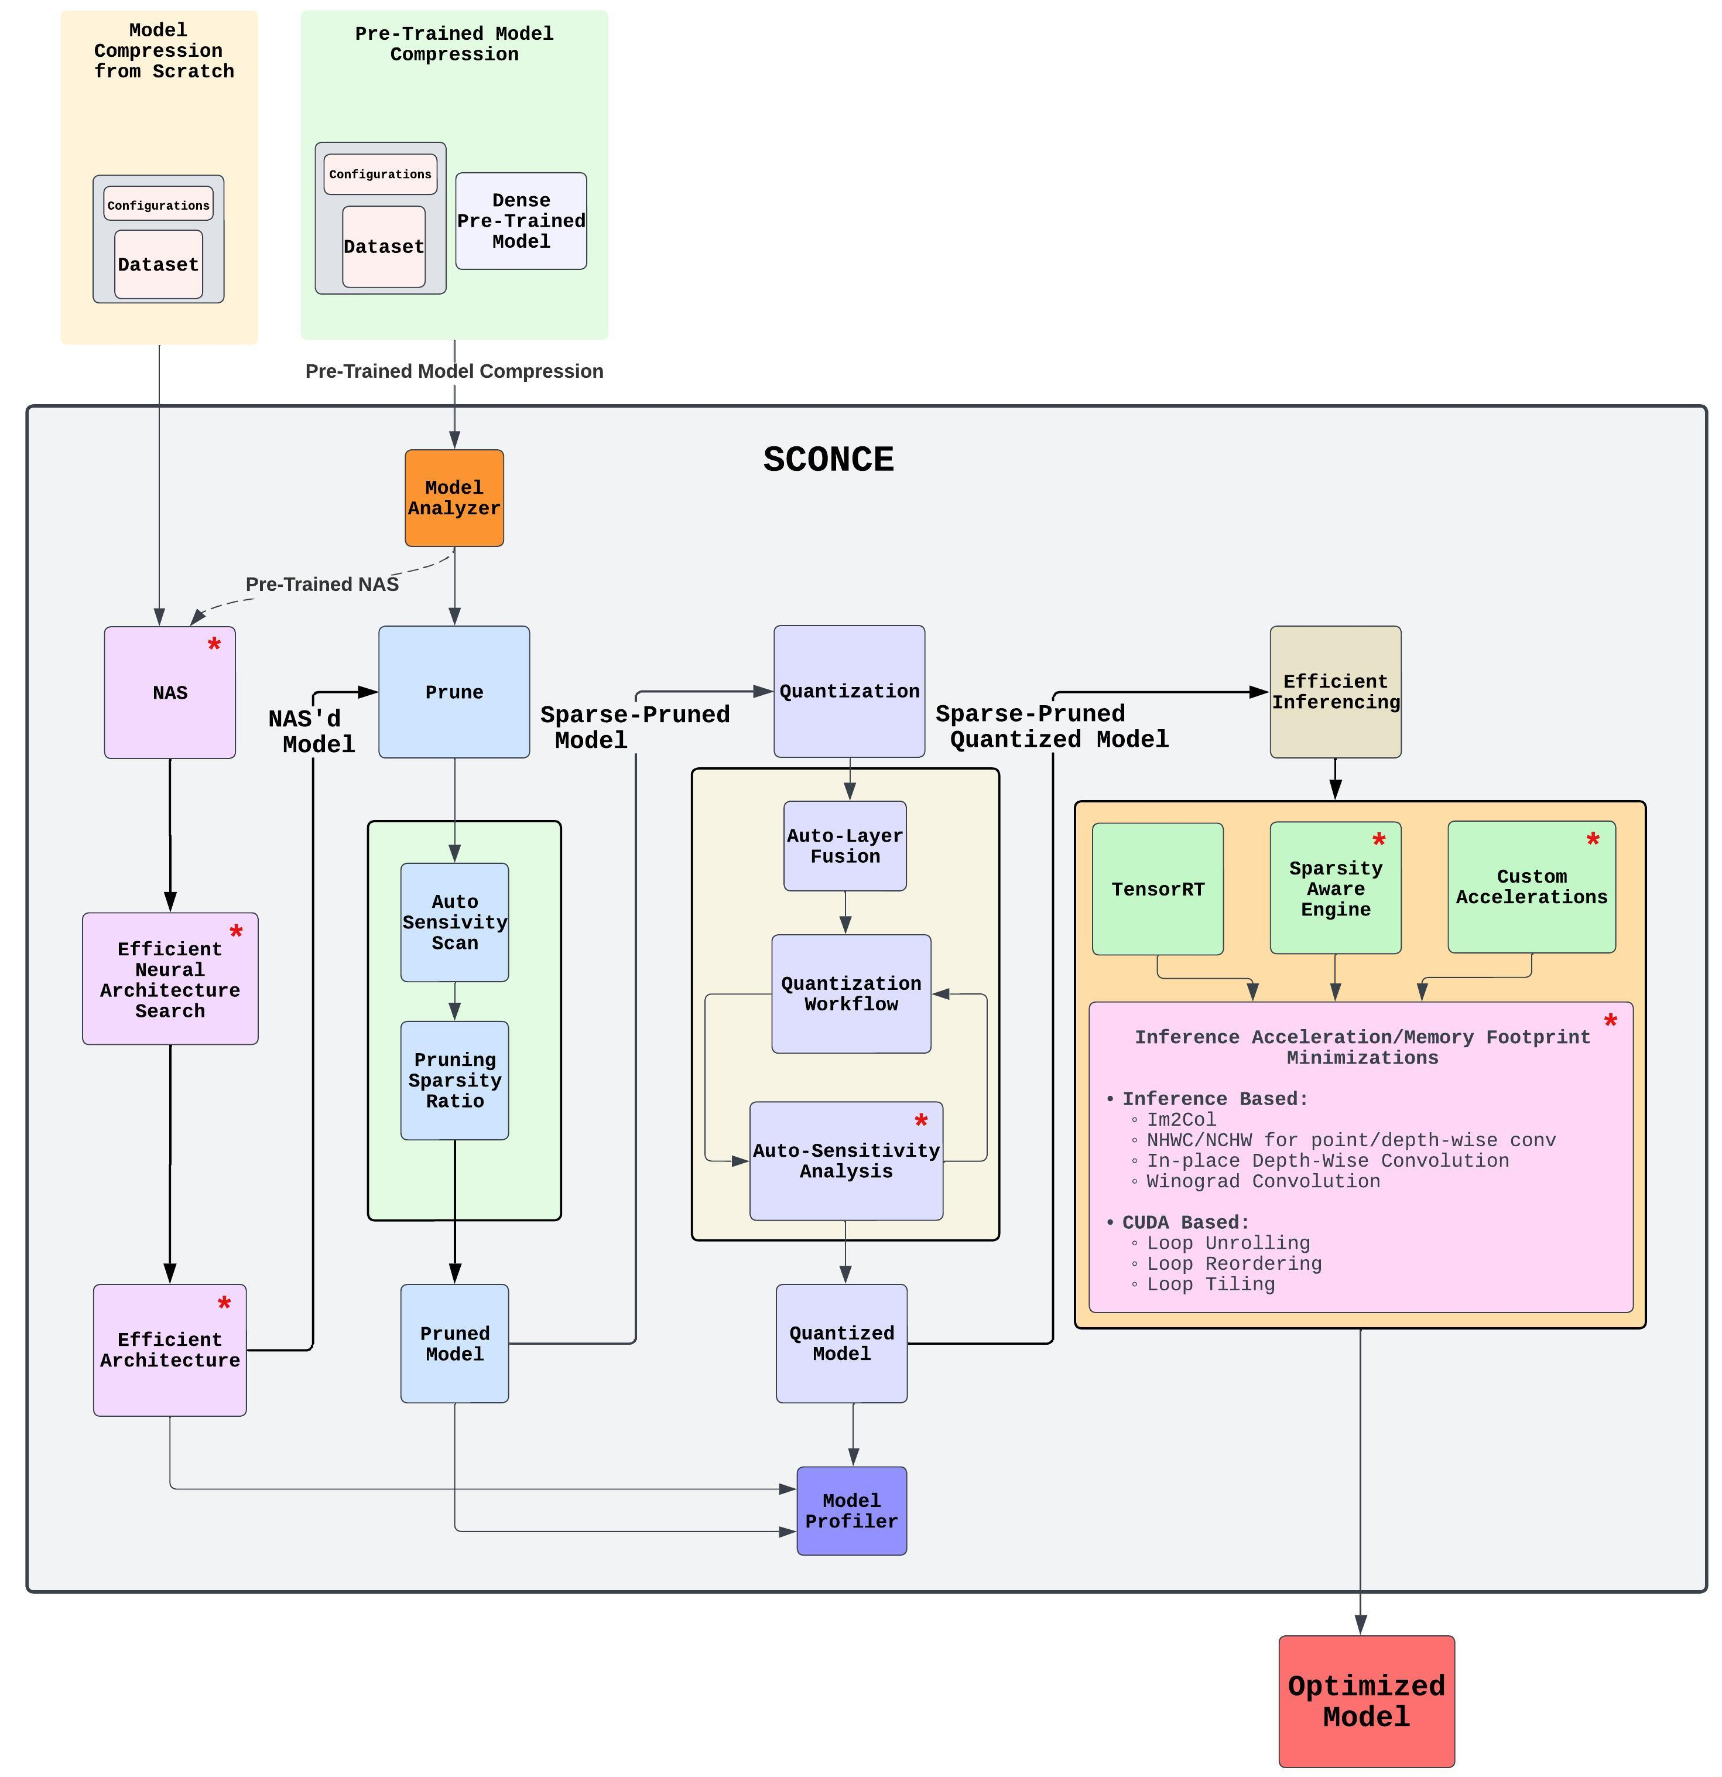
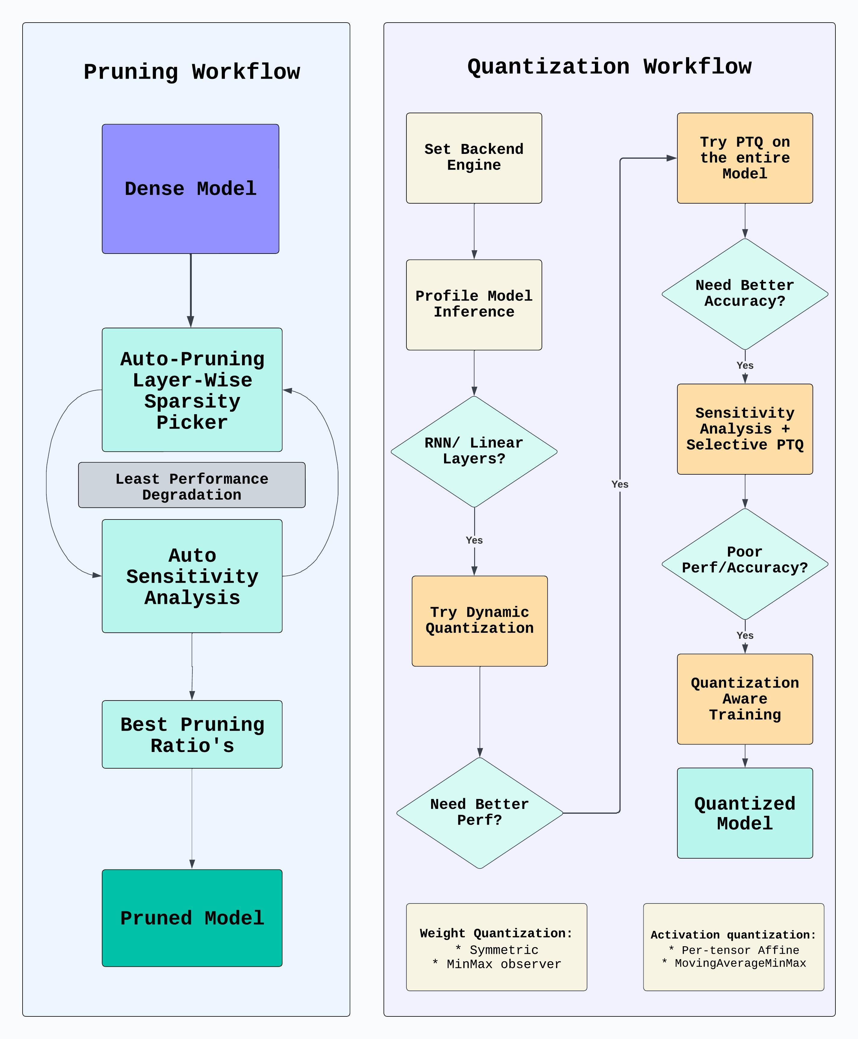
Auto-Sensitivity Scan
Reduce CPM(Compute, Power, Memory) Given the Prune/Quant/etc..
Causing the least/negligible amount of degradation
* - Future Features ( I too have only 24hrs in a day :P)

Slide 3
sconce v1.1

Slide 4
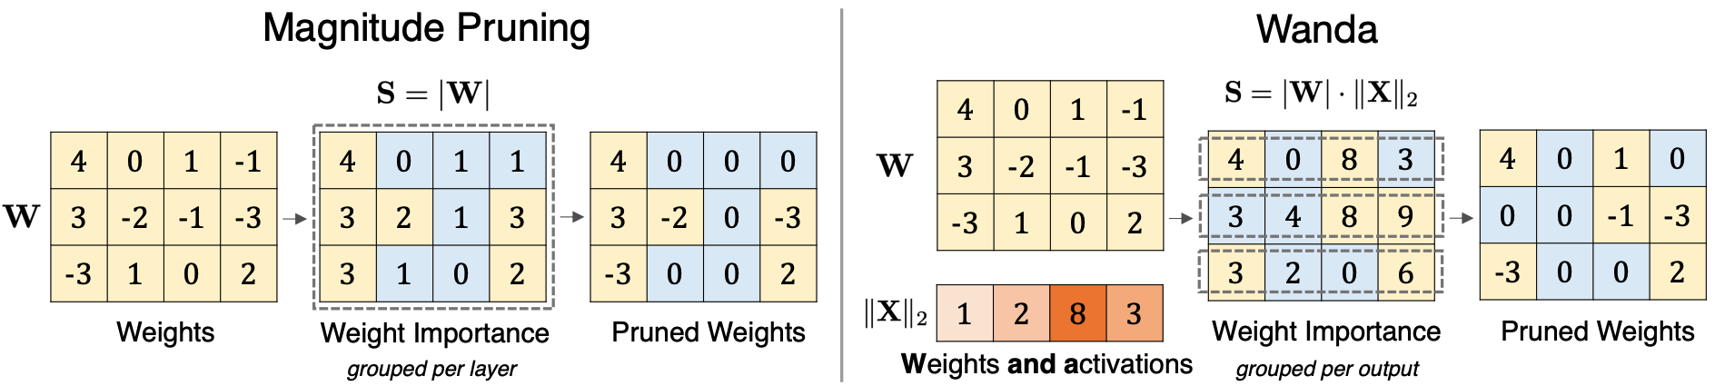
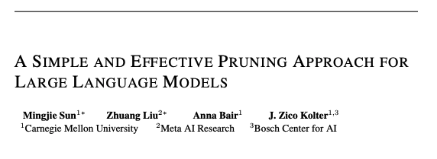
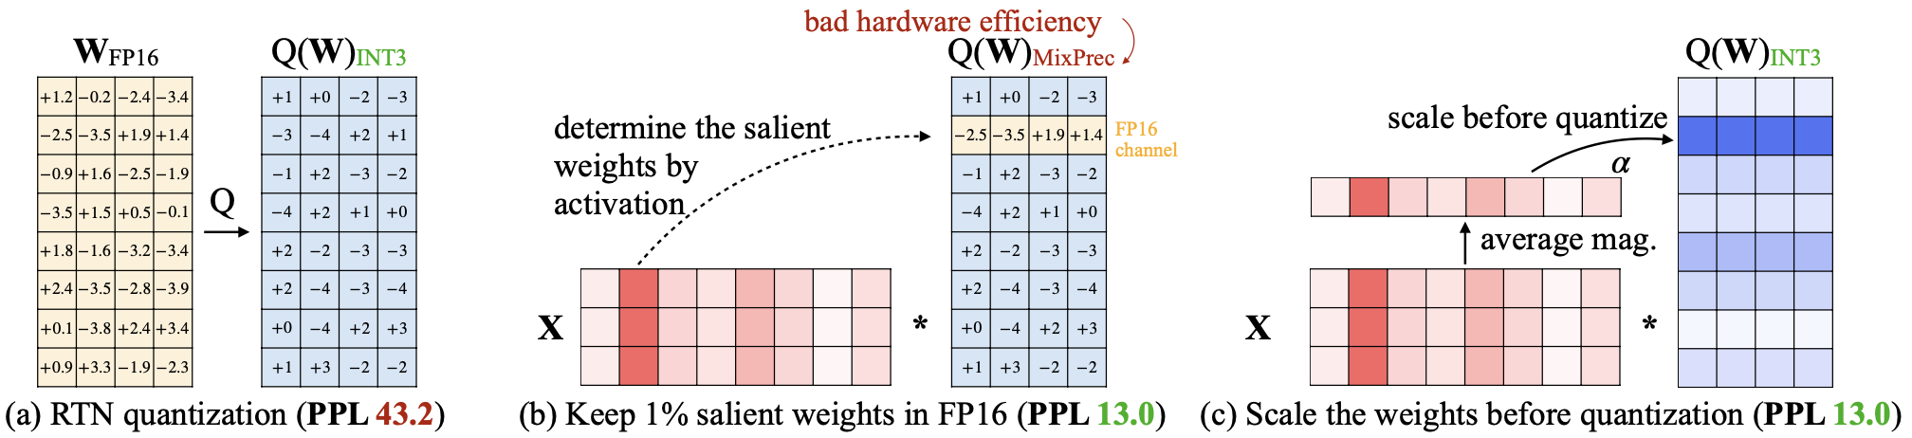
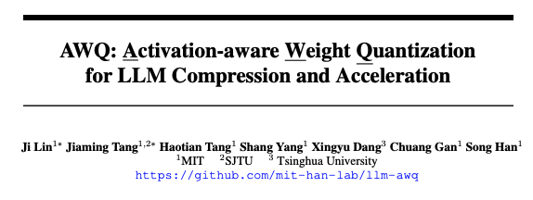
Altruism is all you need !!! Don’t just be self attentive
WANDA: https://github.com/locuslab/wanda
AWQ: https://github.com/mit-han-lab/llm-awq

Slide 5
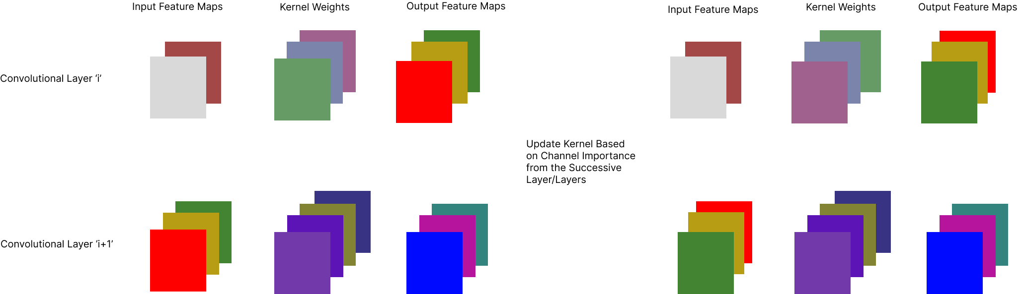
Make Kernels Aware of the Future Kernel Spaces
Code: https://github.com/satabios/sconce/blob/main/tutorials/Pruning.ipynb
Citations:
EIE: https://arxiv.org/abs/1602.01528
Multi-scale channel importance sorting and spatial attention mechanism for retinal vessels segmentation
EACP: An effective automatic channel pruning for neural networks

Slide 6
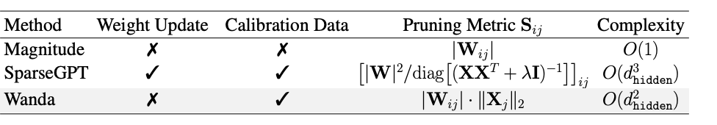
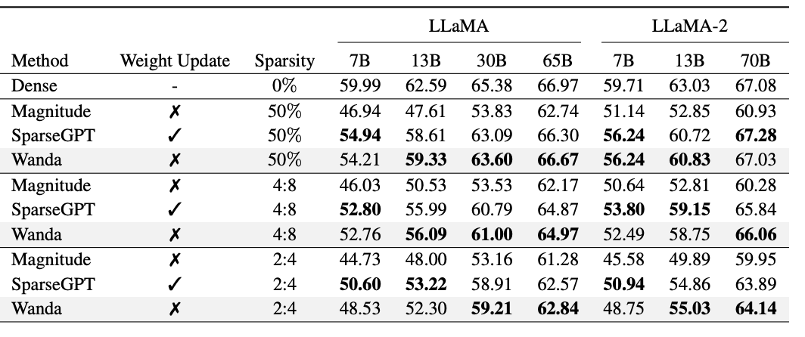
Channel-Based Activation Aware Pruning
But Channel Wise!!
Register hooks to fetch O/P Feature Maps
Run through a Calibration Dataset
Prune Channels(Kernel Weights) Based on Activations

Slide 7
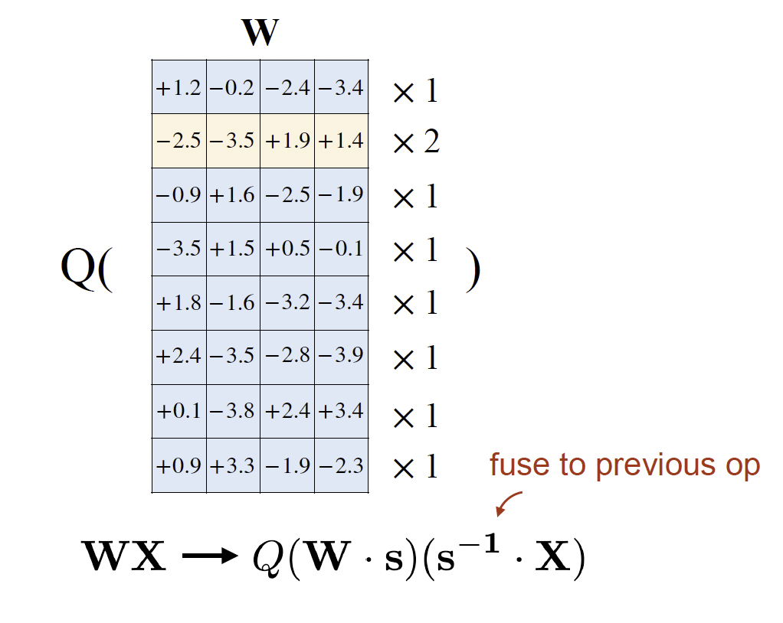
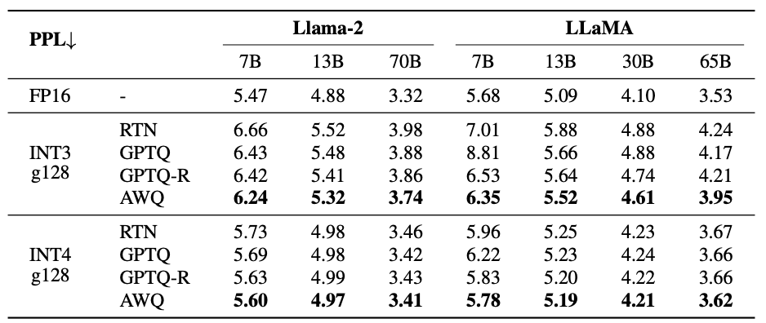
Activation Aware - QAT
But Channel Wise!!
Apply Scaling on Feature Maps based on Activation Saliency
QAT

Slide 8
Complete Flow
Sort Channels Based on Successive Channels
Activation Aware Pruning ( WANDA- like)
Activation Aware Quantization (AWQ- like)

Slide 9
Possible Additions
Layer-Wise Neural Network Compression via Layer Fusion: https://proceedings.mlr.press/v157/o-neill21a/o-neill21a.pdf
Layer-Selective Rank Reduction: https://github.com/pratyushasharma/laser
The Era of 1-bit LLMs: All Large Language Models are in 1.58 Bits: https://arxiv.org/abs/2402.17764

